Slide 1
Alaska Airlines
Flight Delays Project
Alicia Unke
Colorado State University Global
MIS581 Capstone - Business Intelligence and Data Analytics
Osama A. Morad, Ph.D.

Slide 2
Background Information
In 1972, Alaska Airlines was in a financial crisis.
A new business plan was created to set themselves apart from other airlines.
Increase on-time flight performances.
Provide outstanding customer service.
New business plan allowed Alaska Airlines to grow and be profitable for 19 years straight (2020).
Today they continue to stand out with:
Outstanding customer service
By offering more flights to new destinations
Notes:
Alaska Airlines was founded over 85 years ago and in 1972 they found themselves in a financial crisis. Two business partners came together to create a new business plan that would set Alaska Airlines apart from other airlines. The new plan consisted of increasing on-time flight performances and ways to provide outstanding customer service. This philosophy worked so well that it helped the company grow and allowed for nineteen straight years of profitability (2020). Today, Alaska Airlines continues to put their customers first and continue to stand out for their great customer service. They continue to grow by offering more flights to new destinations such as the east coast and to Hawaii.

Slide 3
About The Data Set
Data provided by U.S. Department of Transportation (USDOT).
Managed by the Bureau of Transportation Statistics department.
Purpose of this data set is to track whether flights arrived on time or if they are delayed.
Delayed flights = any flights arriving 15 minutes past the scheduled time.
Flight delay causes are:
Air carrier
Extreme weather
National Aviation System (NAS)
Late-arriving aircraft
Security
Notes:
The data set that was analyzed for this project was provided by the U.S. Department of Transportation (USDOT) and is managed by the Bureau of Transportation Statistics department. The purpose of this data set is to track whether flights arrived on time or if they are delayed. A flight is considered delayed if they arrived 15 minutes past their scheduled time. This data set tracks the number of flights that were delayed by breaking them down into five categories: Air carrier (due to circumstances within the airline’s control); extreme weather (tornado, blizzards, hurricanes, ect.); National Aviation System (NAS) (airport operations, heavy traffic volume, air traffic control); late-arriving aircraft (previous flight arrived late causing present flight to depart late); and security (security breaches, tsa long lines in excess of 29 minutes) (US DOT, 2020).

Slide 4
Tools and Techniques
Programs used:
SAS Studio
Python Jupyter
The four steps for hypothesis testing are:
State the two hypotheses so that only one can be right.
Formulate an analysis plan which outlines how the data will be evaluated.
Carry out the plan and physically analyze the sample data.
Analyze the results and given the data, either reject the null hypothesis or state that the null hypothesis is plausible (Majaski, 2020).
Notes:
The programs used to analyze the data are SAS Studios and Python Jupyter. In SAS Studios, the summary statistics test was performed for both hypotheses questions. Python Jupyter was used to back up the results provided by SAS Studios and to create visualizations. The results in both programs were analyzed to determine if the null hypothesis should be rejected or not. Christina Majaski (2020) states that there are four steps for hypothesis testing and my portfolio project followed these steps. The four steps are:
State the two hypotheses so that only one can be right.
Formulate an analysis plan which outlines how the data will be evaluated.
Carry out the plan and physically analyze the sample data.
Analyze the results and given the data, either reject the null hypothesis or state that the null hypothesis is plausible (Majaski, 2020).

Slide 5
Security, Privacy, and Ethics
Security and privacy challenges:
Cloud configuration problems
Weak identity governance
Clashing application softwares
Glitchy new software
Remote data storage (Rice, 2019).
“Ethical challenges occur when opinions on what is considered right and wrong deviate” (Jha, 2019).
Ethical challenges:
Unfair discrimination
Reinforcement of human biases
Lack of transparency
Notes:
Big datasets have many security concerns due to their size. Some security issues are caused by: cloud configuration problems, weak identity governance, clashing application softwares, glitchy new software, and remote data storage (Rice, 2019). “Ethical challenges occur when opinions on what is considered right and wrong deviate” (Jha, 2019). Unfair discrimination, reinforcement of human biases, and lack of transparency are three ethical challenges that relate to data analysis. There are not many laws regulating data ethics, so one challenge is defining what is considered ethical and not while pulling data for a project.

Slide 6
Business and Hypothesis Questions
What reason contributes to the most number of flight delays?
Null Hypothesis: The most flight delays are because of the Air Carrier.
Alternate Hypothesis: The most flight delays are not because of the Air Carrier.
Is there a greater number of flights arriving on time vs the flights that are delayed?
Null Hypothesis: There is not a number percentage of on time flights then delayed flights.
Alternate Hypothesis: There is a greater number of on time flights then delayed flights.
Notes:
One of Alaska Airlines main goals is to provide the best customer experience. One way to do that is to ensure flights arrive and take off on time. For this portfolio project, the business questions we will be trying to answer along with the hypothesis are:
What reason contributes to the most number of flight delays?
- Null Hypothesis: The most flight delays are because of the Air Carrier.
- Alternate Hypothesis: The most flight delays are not because of the Air Carrier.
Is there a greater number of flights arriving on time vs the flights that are delayed?
- Null Hypothesis: There is not a number percentage of on time flights then delayed flights.
- Alternate Hypothesis: There is a greater number of on time flights then delayed flights.

Slide 7
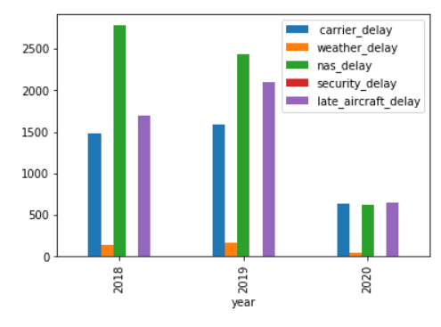
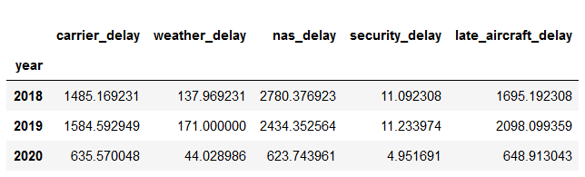
Business Question #1 Results
In 2018 & 2019, top 3 reasons for flight delays are:
NAS
Late aircraft
Air carrier
In 2020, top 3 reasons are:
Late aircraft
Air Carrier
NAS
Notes:
After several analysis, the results from the first business question ‘What reason contributes to the most number of flight delays?’ proves we need to reject the null hypothesis and accept the alternate. The bar graph shows the average number of flights in each category per year. According to the chart and graph in 2018 and 2019 the biggest reasons for flight delays are due to NAS. This refers to the overall airport operations such as air traffic control and or air field congestion. Late aircraft followed by air carrier are the second and third reasons for flight delays. In 2020 however the results changed. Late aircraft was the top reason followed by air carrier and then NAS.

Slide 8
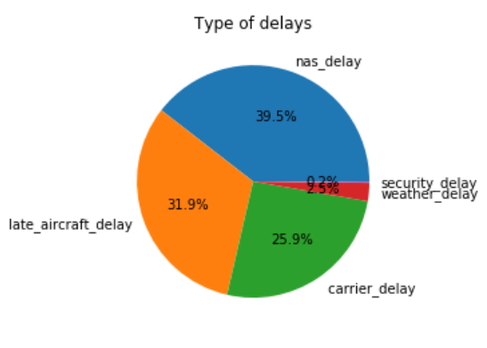
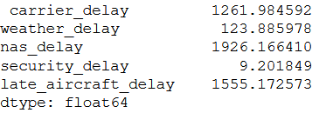
Business Question #1 Results Cont.
Overall results show main causes of flight delays are:
NAS = 39.5%
Late aircraft = 31.9%
Air carrier = 25.9%
Weather = 2.5%
Security = 0.2%
Notes:
Overall, by combining all the data together NAS was still the top reasons for flight delays with a percentage of 39.5% out off all the flights. Late aircraft and air carrier came in second and third. This means if an incoming flight arrives late then the following flight is also considered late because it has to leave later than the expected departure time. This is important information for airlines because schedules need to accommodate for late arrivals in order to stop the chain of events of late departures from happening. This is important information for Alaska Airlines because air carrier refers to things that they have control over. So if Alaska can find solutions to prevent them from having to delay flights it will improve their performance.

Slide 9
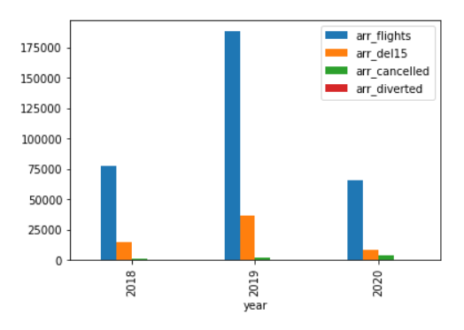
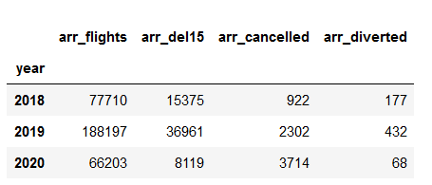
Business Question #2 Results
Flight performance outcome per year:
Arrived on time
Delayed at least 15 minutes
Cancelled
Diverted
Notes:
In order to answer the second business question, ‘Is there a greater number of flights arriving on time vs flights that are delayed?’, an analysis of the variables in the data set needed to be performed. Based on the results during all three years flights arrived on time more often than delayed or cancelled flights. This is good news for Alaska Airlines because on time flight performance affects customer satisfaction.

Slide 10
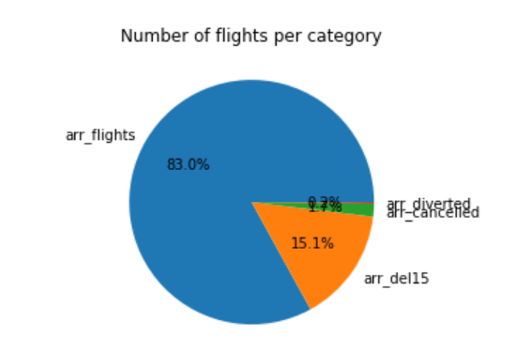
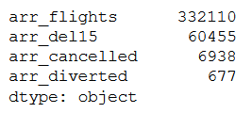
Business Question #2 Results Cont.
Overall results show flight performance as follows:
Arrive on time = 83%
Delayed by 15 minutes = 15.1%
Cancelled = 1.7%
Diverted = 0.2%
Notes:
By combining all the data together and looking at the overall results, it seems we get the same outcome as breaking it down by individual years. Flights arrived on time 83% of the time followed by being delayed only 15.1 % of the time. This means we can reject our null hypothesis and accept the alternate hypothesis.

Slide 11
Conclusion
Majority of the flights arrive on time.
The flights that are delayed are caused by NAS followed by late aircraft arrival.
Alaska Airlines can prevent further late arrivals by adjusting the flight schedule.
Preventing delays helps maintain satisfied customers.
Notes:
To sum up our findings, we learned that the majority of flights do arrive on time and the main cause of delayed flights is because of NAS. While Alaska can’t prevent delays due to NAS, they can take this information and adjust their flight schedules to prevent future late arrivals from occurring. By adjusting their schedules to accomidate unpredicted late arrivals they can stop the chain of effect from having future late arrivals. By decreasing delays and improving profits, Alaska Airlines will continue to be able to invest in new innovations and provide the best customer service.

Slide 12
References
Alaska Airlines History. (2020). Retrieved from https://www.alaskaair.com/content/about-us/history
Jha, S. (2019, January 04). The Ethical Challenges Of A Data Science Practitioner. Retrieved from https://blog.quantela.com/the-ethical-challenges-of-a-data-science-practitioner/
Majaski, C. (2020, January 27). Hypothesis Testing. Retrieved from https://www.investopedia.com/terms/h/hypothesistesting.asp
Rice, M. (2019, August 26). 7 Big Data Security Issues to Consider. Retrieved from https://builtin.com/big-data/big-data-security
US DOT. (2020, March 05). Airline On-Time Performance and Causes of Flight Delays. Retrieved from https://www.bts.dot.gov/explore-topics-and-geography/topics/airline-time-performance-and-causes-flight-delays

